Slide 1
Introduction to Data Science
Dr. Alexander Victor
Alexander.victor@dbs.ie

Slide 2


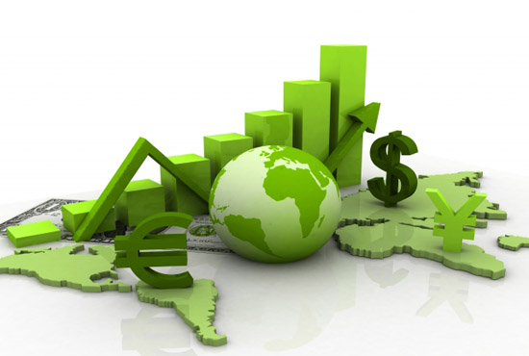
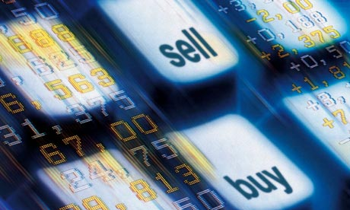
Data All Around
Lots of data is being collected and warehoused
Web data, e-commerce
Financial transactions, bank/credit transactions
Online trading and purchasing
Social Network

Slide 3
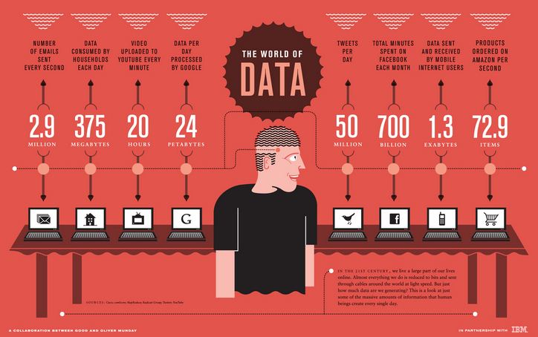
How Much Data Do We have?
Google processes 20 PB a day (2008)
Facebook has 60 TB of daily logs
eBay has 6.5 PB of user data + 50 TB/day (5/2009)
1000 genomes project: 200 TB
Cost of 1 TB of disk: $35
Time to read 1 TB disk: 3 hrs
(100 MB/s)

Slide 4
Big Data
Big Data is any data that is expensive to manage and hard to extract value from
Volume
The size of the data
Velocity
The latency of data processing relative to the growing demand for interactivity
Variety and Complexity
the diversity of sources, formats, quality, structures.

Slide 5
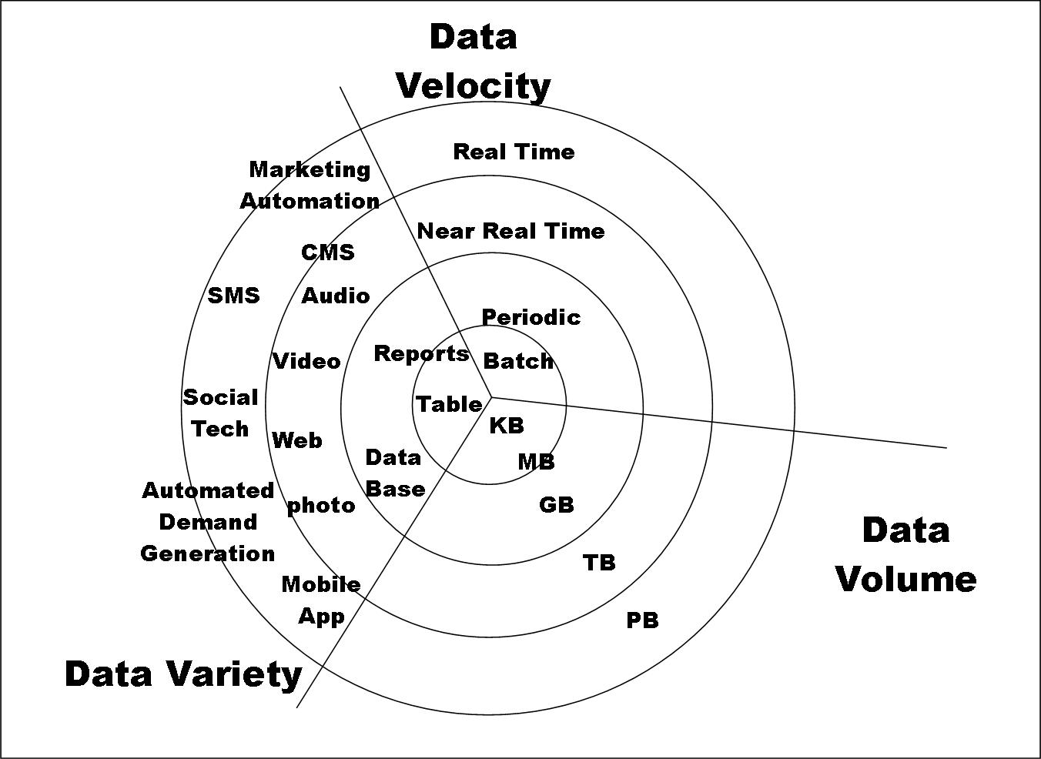
Big Data

Slide 6
Types of Data We Have
Relational Data (Tables/Transaction/Legacy Data)
Text Data (Web)
Semi-structured Data (XML)
Graph Data
Social Network, Semantic Web (RDF), …
Streaming Data
You can afford to scan the data once

Slide 7
What To Do With These Data?
Aggregation and Statistics
Data warehousing and OLAP
Indexing, Searching, and Querying
Keyword based search
Pattern matching (XML/RDF)
Knowledge discovery
Data Mining
Statistical Modeling

Slide 8
Big Data and Data Science
“… the sexy job in the next 10 years will be statisticians,” Hal Varian, Google Chief Economist
The U.S. will need 140,000-190,000 predictive analysts and 1.5 million managers/analysts by 2018. McKinsey Global Institute’s June 2011
New Data Science institutes being created or repurposed – NYU, Columbia, Washington, UCB,...
New degree programs, courses, boot-camps:
e.g., at Berkeley: Stats, I-School, CS, Astronomy…
One proposal (elsewhere) for an MS in “Big Data Science”

Slide 9
What is Data Science?
An area that manages, manipulates, extracts, and interprets knowledge from tremendous amount of data
Data science (DS) is a multidisciplinary field of study with goal to address the challenges in big data
Data science principles apply to all data – big and small
https://hbr.org/2012/10/data-scientist-the-sexiest-job-of-the-21st-century/

Slide 10
What is Data Science?
Theories and techniques from many fields and disciplines are used to investigate and analyze a large amount of data to help decision makers in many industries such as science, engineering, economics, politics, finance, and education
Computer Science
Pattern recognition, visualization, data warehousing, High performance computing, Databases, AI
Mathematics
Mathematical Modeling
Statistics
Statistical and Stochastic modeling, Probability.

Slide 11
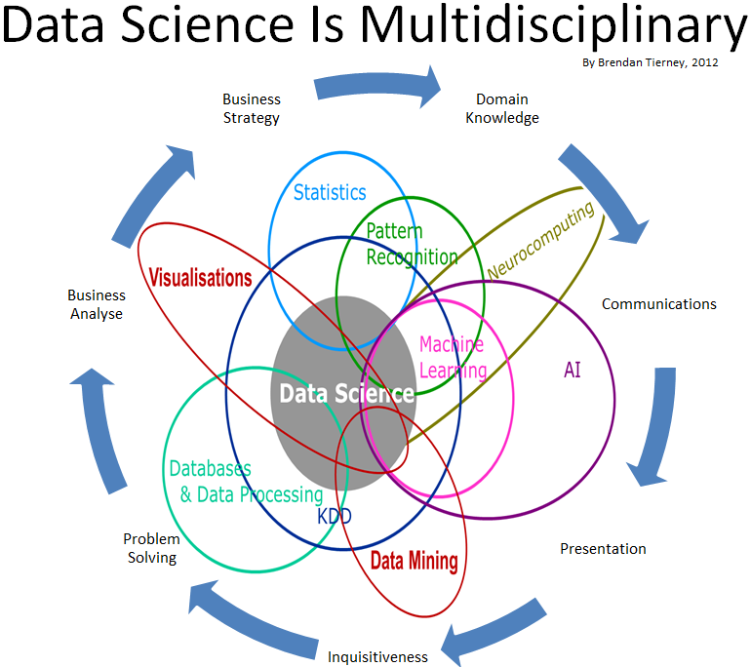
Data Science

Slide 12
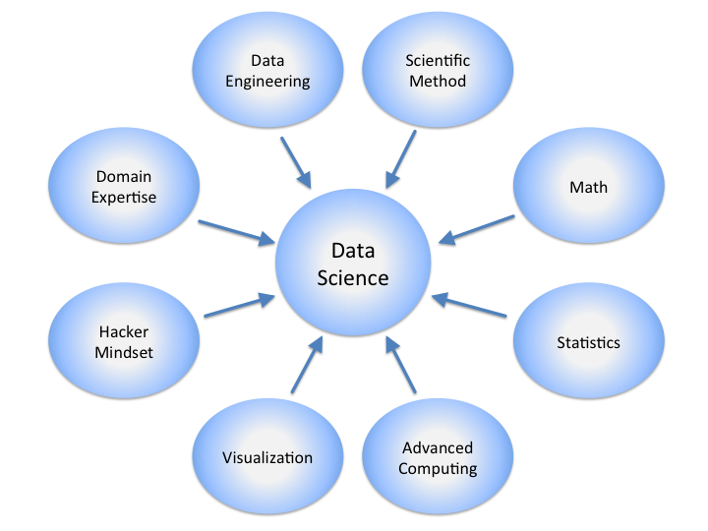
Data Science

Slide 13
Real Life Examples
Companies learn your secrets, shopping patterns, and preferences
For example, can we know if a woman is pregnant, even if she doesn’t want us to know? Target case study
Data Science and election (2008, 2012)
1 million people installed the Obama Facebook app that gave access to info on “friends”

Slide 14
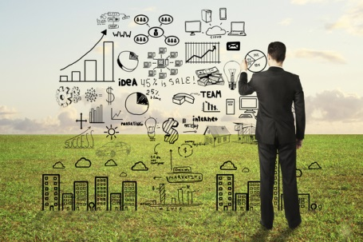
Data Scientists
Data Scientist
The Sexiest Job of the 21st Century
They find stories, extract knowledge. They are not reporters

Slide 15

Data Scientists
Data scientists are the key to realizing the opportunities presented by big data. They bring structure to it, find compelling patterns in it, and advise executives on the implications for products, processes, and decisions

Slide 16
What do Data Scientists do?
National Security
Cyber Security
Business Analytics
Engineering
Healthcare
And more ….

Slide 17
Concentration in Data Science
Mathematics and Applied Mathematics
Applied Statistics/Data Analysis
Solid Programming Skills (R, Python, Julia, SQL)
Data Mining
Data Base Storage and Management
Machine Learning and discovery

Slide 18
Data Analytics
Examining Raw Data
Drawing Conclusions
Lake & Stream

Slide 19
Data Analytics
DATA LAKE DATA STREAM
Storage
Long-term historical data
Easy
Real-time data
Parallel analysis
Difficult

Slide 20
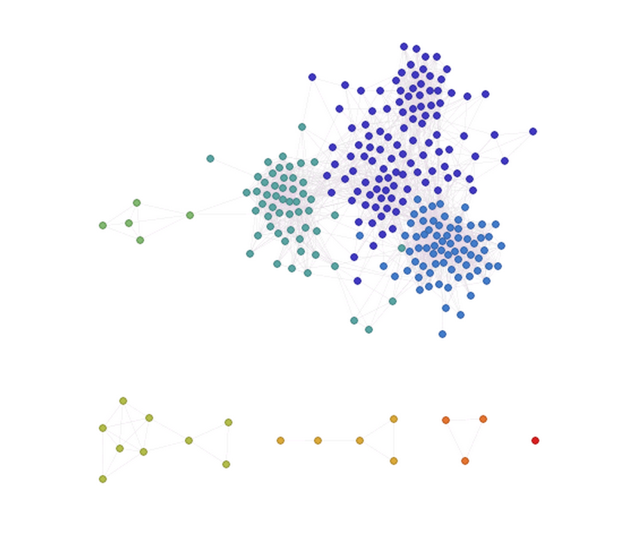
Facebook Friends
Undergraduate Degree
Home Town
Housemates
Archery Clubs
Work Placement
Graduate Mixer

Slide 21
Facebook Friends
Technical Communication
Lu Xin
Damien Lafferty
Niall Turbitt
Sean Cawley
Georg Christian

Slide 22
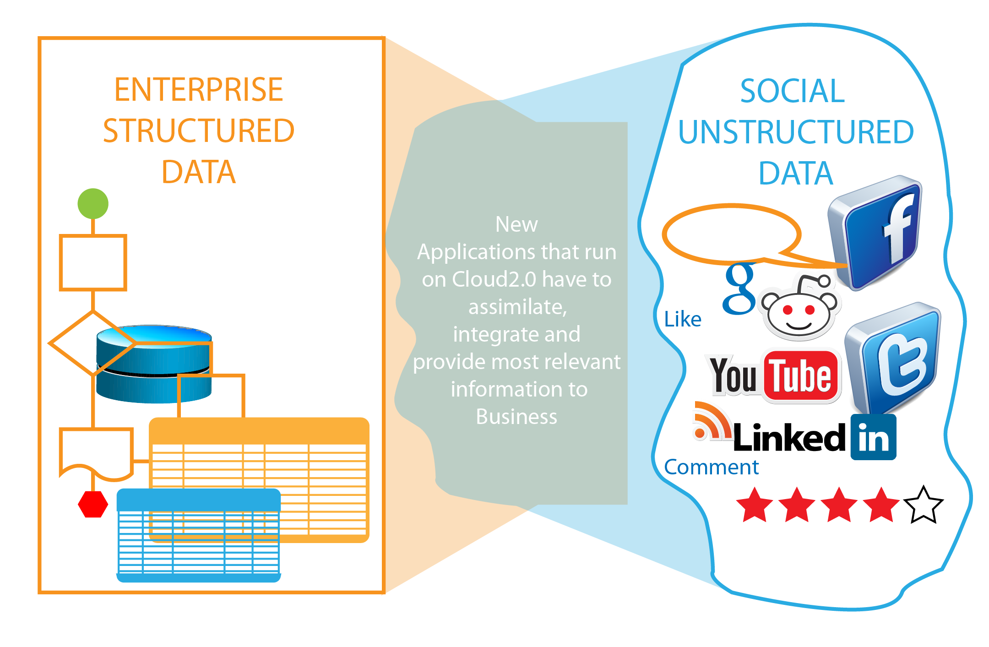
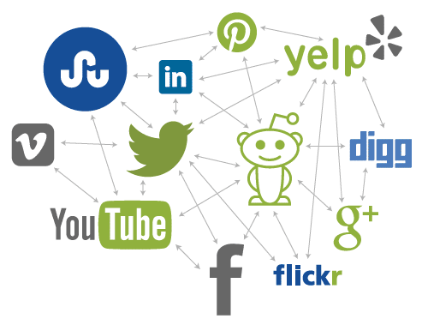
Structured Data
Unstructured Data

Slide 23
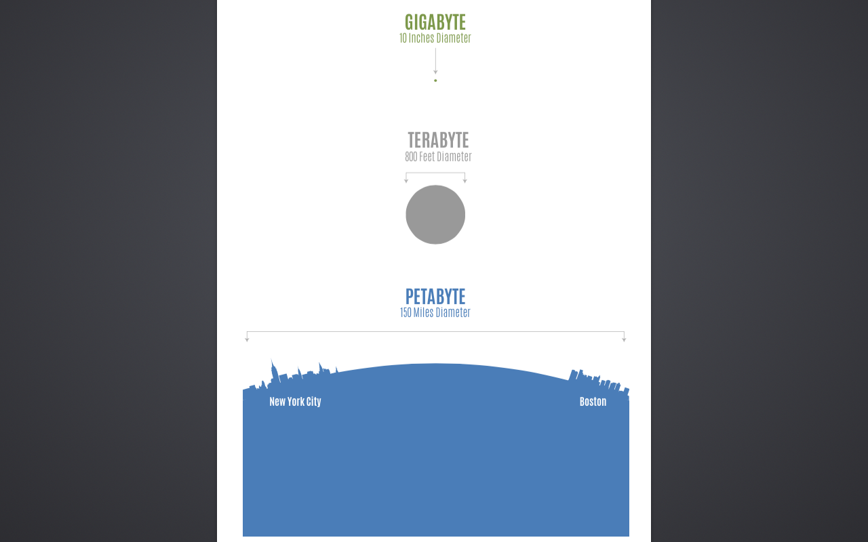
80% of all data is unstructured data
Unstructured data estimated at 3,000,000 petabytes
Relative distance from the Earth to Jupiter
Dublin
Cork

Slide 24
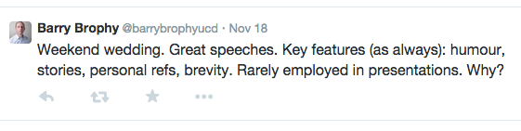
Text
Forms the majority of unstructured data
Nearly one million bits of content shared on Facebook every minute
Over 100,000 tweets per minute

Slide 25
Text Mining Example
People’s mood on coffee, wine, beer and soda from Twitter
Compare tweets to database of positive and negative words
Calculate a sentiment score:
Score = # of Positive Words - # of Negative Words
If Score > 0 - 'positive opinion'
If Score < 0 - 'negative opinion'
If Score = 0 - 'neutral opinion'

Slide 26
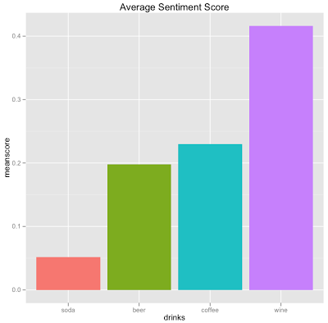

Slide 27
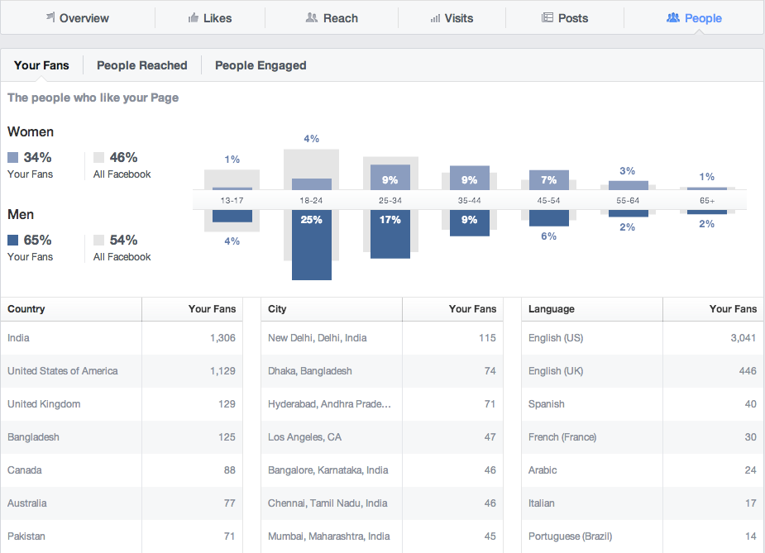

Slide 28
Python
Python is an open source programming language that uses an environment to compile and execute code.
These environments give a visual appeal to using python along with the ease of integrating other languages
Python prioritises simple programming where readability is a large factor.
Python is Indentation based , putting importance on the indentation of a code for its execution
As the program is relatively simple with easy to learn syntax yet equally as powerful, it can be a great starting language

Slide 29
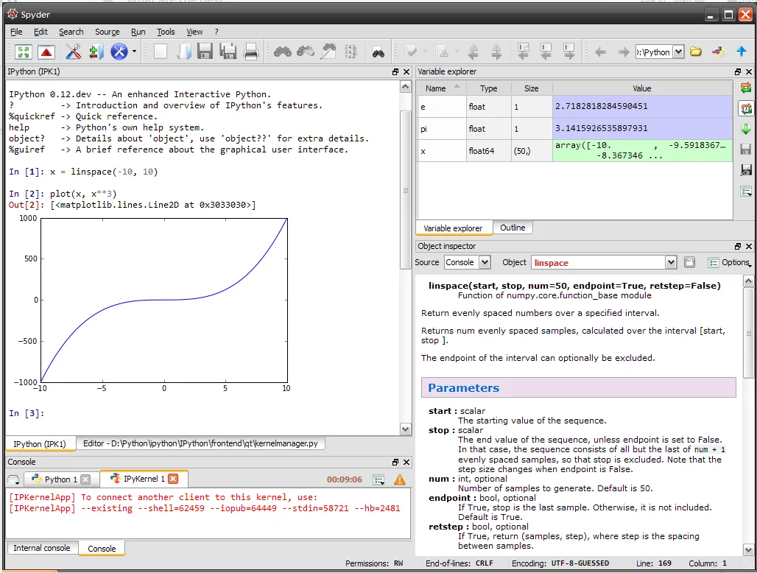

Slide 30
Libraries
Python libraries are collections of related modules containing groups of code for use in programs
Pythons extensive libraries make it a popular choice for data analysis
Each library needs to be imported into the environment before its methods and objects can be utilised

Slide 31
Essential Libraries
For this course there are several libraries that will be needed
NumPy; numerical computing library
Pandas; for high-level data structures and functions
Matplotlib; produces plots and other 2D data visualisations
SciPy; addresses standard scientific problems
Scikit-learn; general purpose machine learning toolkit
Statsmodels; statistical analysis package

Slide 32
Installation
To install your environment following the corresponding installation advice whether it be installing Spyder, Anaconda or any other environment.
To check everything is properly configured, open command prompt and type python
A message of the corresponding installed environment should appear

Slide 33
Package install/update
conda install package_name
pip install package_name
conda update package_name
pip install --upgrade package_name

Slide 34
Import conventions
import numpy as np
import matplotlib.pyplot as plt
import pandas as pd
import seaborn as sns
import statsmodels as sm

